Slide 1
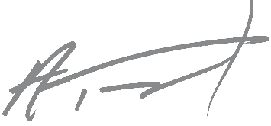
2020 Malbec
Vineyards:
Southwind & Summit View
AVA
Walla Walla Valley
Blend:
90% Malbec, 10% Cabernet Sauvignon
Alcohol:
14.7%
pH: 3.76
Oak
20% new French, 80% neutral
Aging:
19 months
Total Production
257 cases
Description
Blueberries, blackberries, white pepper, bark and steak. Viscous mid-palate. Some mineral notes of wet river stone, with cumin, plum and marmalade.
The Art & Wine
Lucas Dumrauf, Guamini, Argentina.
Photograph: “Two Rocks” taken October 2, 2016.
Ashley Trout, Owner & Winemaker
1249 Lyday Land, Walla Walla, WA 99362 | 509-563-2191 | wine@brookandbull.com | brookandbull.com

