Slide 1
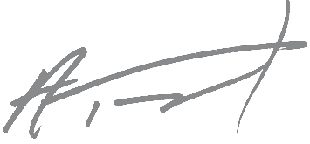
2020 Reserve malbec
AVA
Walla Walla Valley
Blend:
100% Malbec
Alcohol:
14.6%
Ph: 3.80 pH
Oak
Aging:
18 months neutral oak
Total Production
288 cases bottled
Description
Cigar and plums, brambleberry pie, all kinds of blackberry, raspberry, huckleberry, the works. 1985 cherry coke. Caper berries, leather and lemon. This wine is one of the most tactile we’ve ever made- tannins, mid-palate chewiness, acid, it’s all there.
The Art & Wine
Brendon Holt
Brendon is pretty off the grid. All he gave us when I finally found him was the following:
Bio: Occasional photographer, off and on scribbler of words, rider and tinkerer of bicycles. Can commonly be found strolling or pedaling among the peaks and foothills of the Rocky Mountains of Montana.
This photo:
Photo Description: Pictured is an old snag submerged in one of the many wetland ponds that dot the forested banks of the Snohomish River in Washington State. Taken on one of my many rambles through the beautiful Lord Hill Regional Park when I lived in the area.
Ashley Trout, Owner & Winemaker
1249 Lyday Lane, Walla Walla, WA 99362 | 509-563-2191 | wine@brookandbull.com | brookandbull.com

